Slide 1

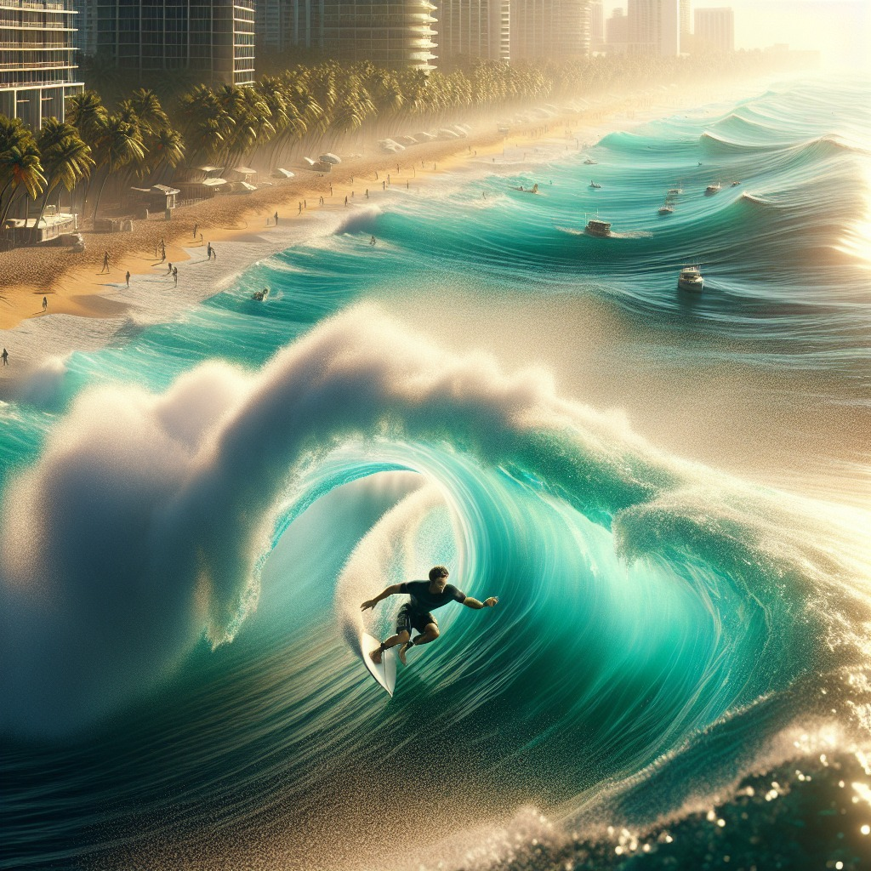
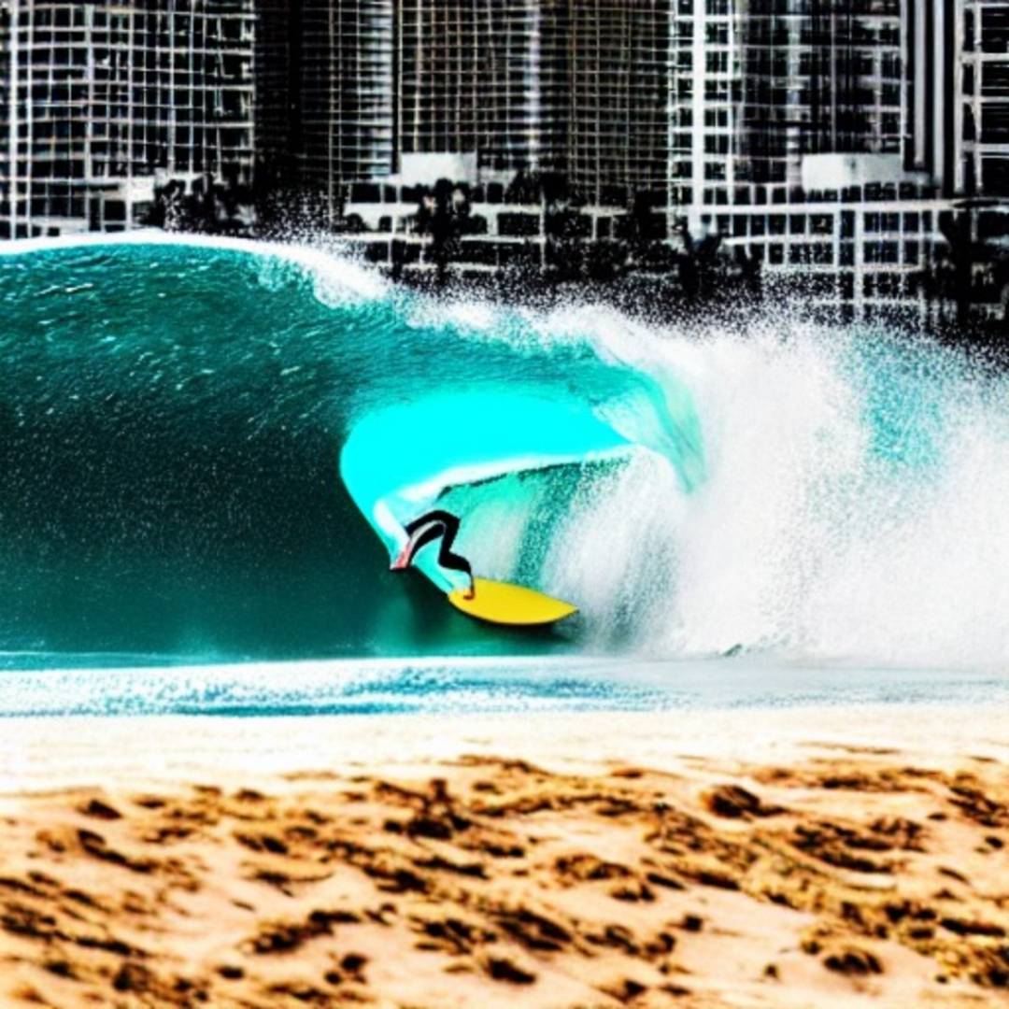
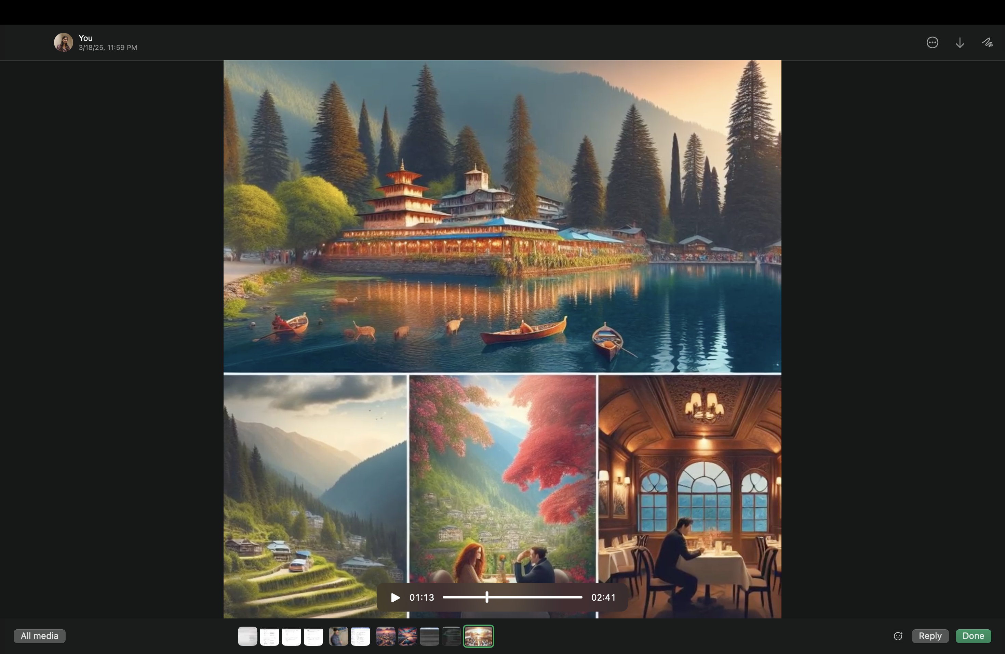
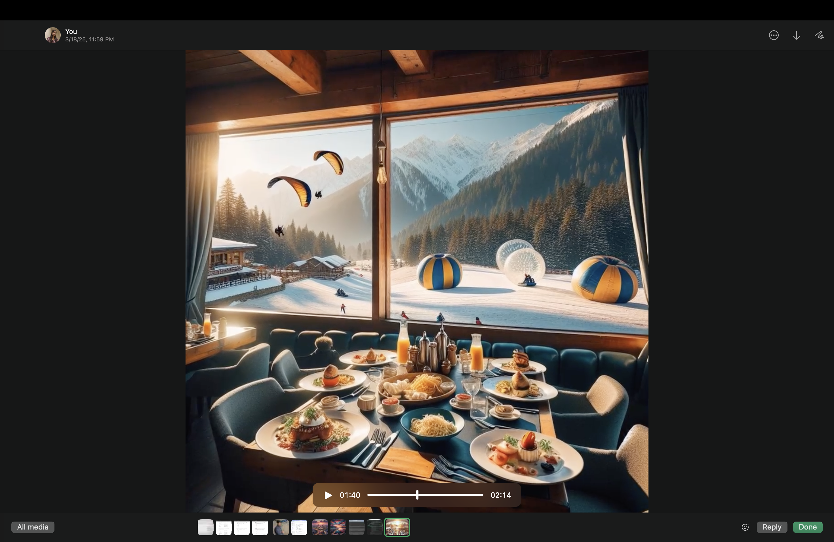
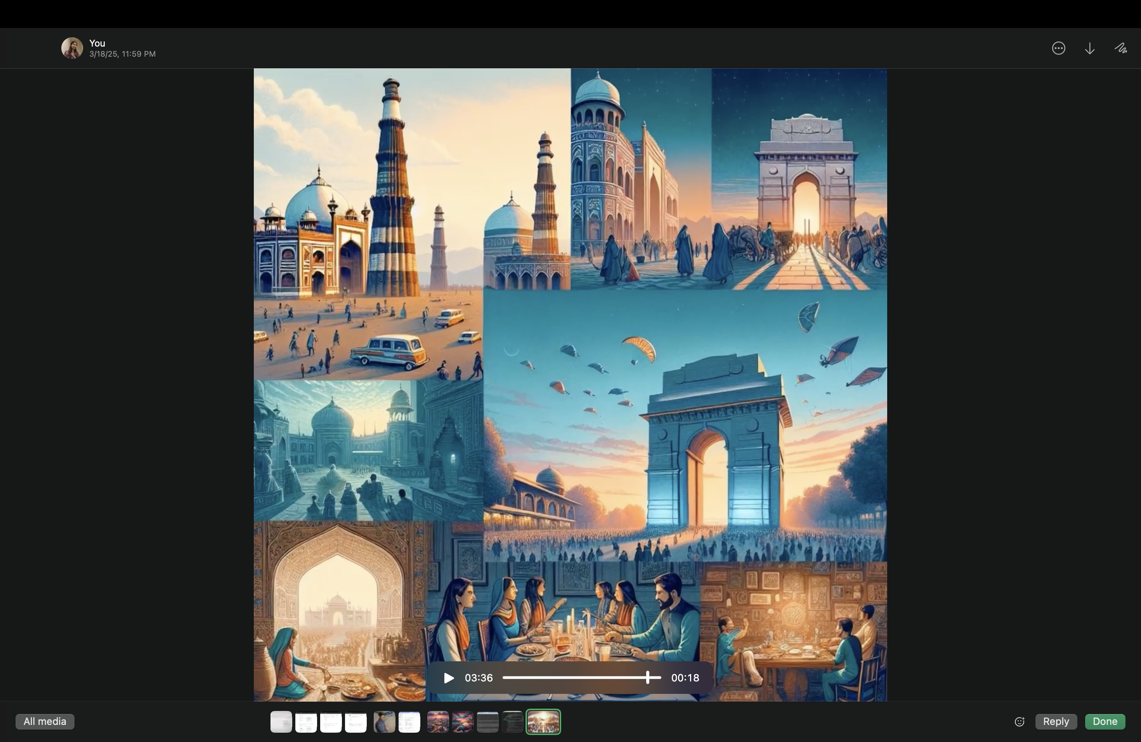
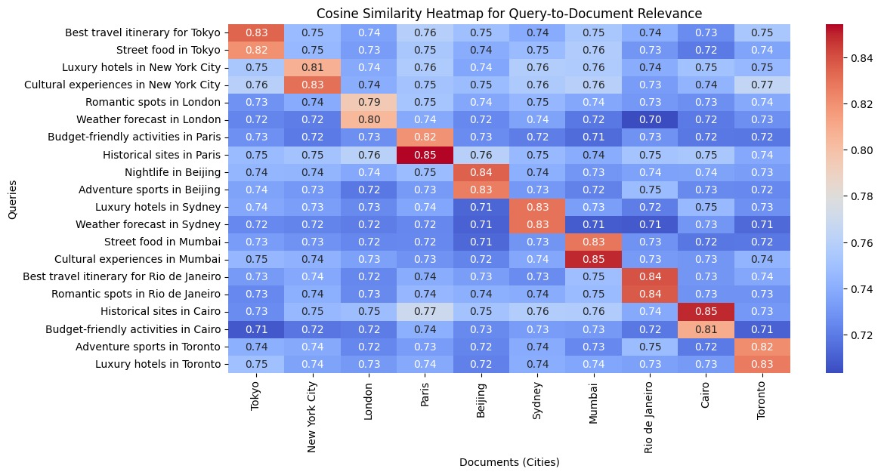
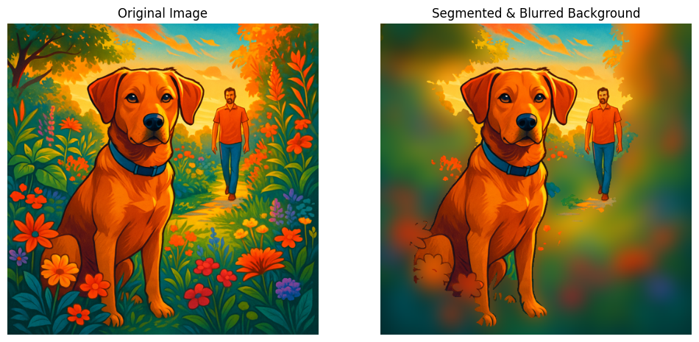
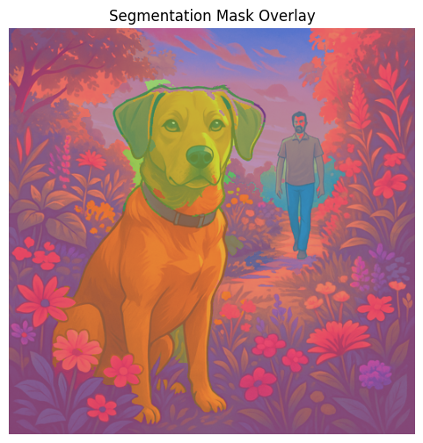
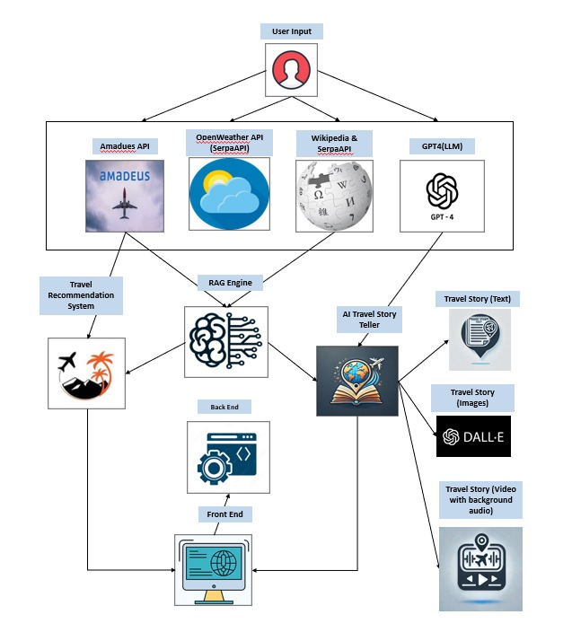
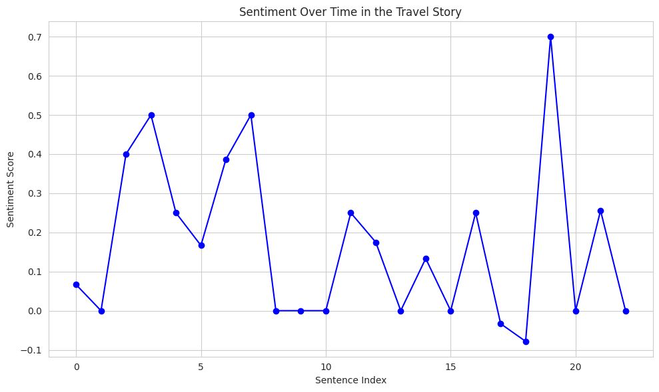
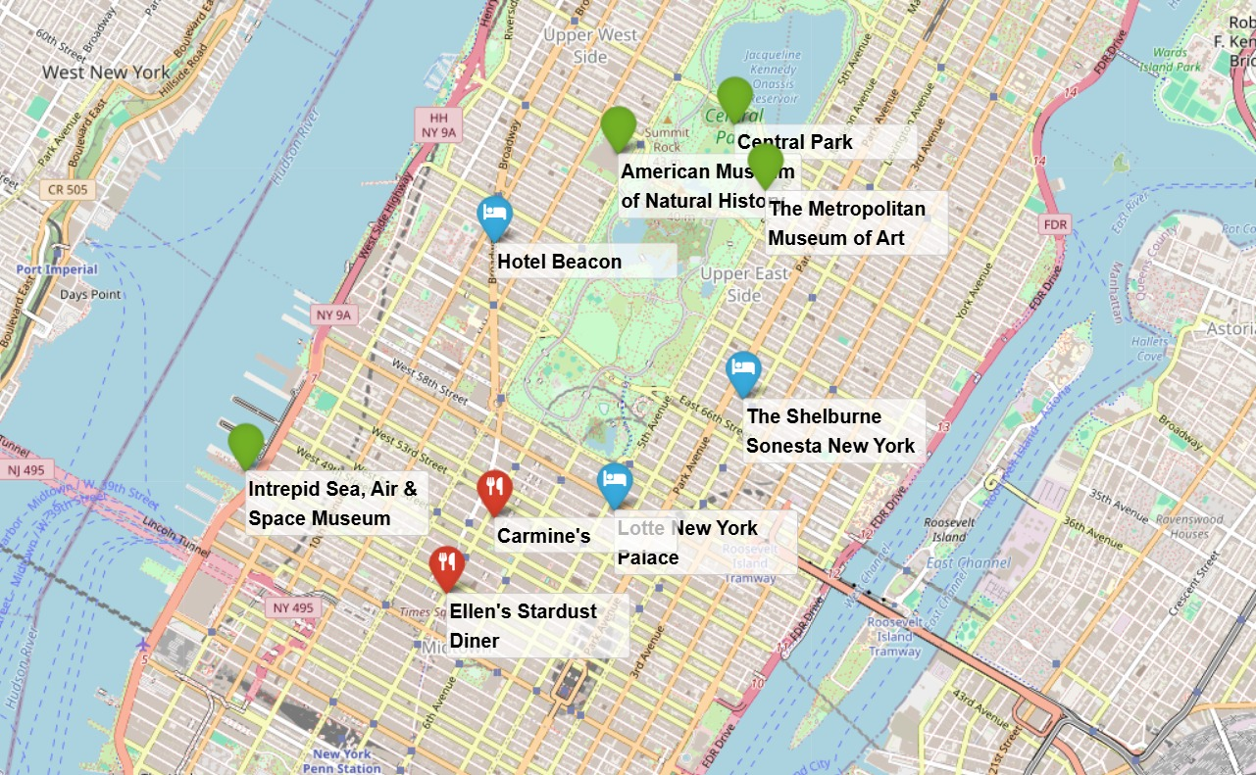

WanderTales: AI-Powered Travel Stories & Recommendations
Experience Your Journey Before It Begins – Smart AI Travel Planning
Viswanth Tamanna, Dharani Thakkallapally, Pavan Sundar Reddy, Banu Teja Jampani
Background
Comparision of Methods
Results & Discussion
Existing travel recommendation systems provide generic, static suggestions without considering real-time updates, user preferences, or contextual relevance, making trip planning inefficient and impersonal.
This project leverages retrieval-augmented generation (RAG) and FAISS-based vector search to dynamically curate travel recommendations based on user interests, recent trends, and real-time data.
Unlike conventional planners, this system not only assists in travel planning but also generates AI-driven travel narratives, offering users a seamless way to document and relive their experiences.
DALL-E | Stable diffusion
Captures details well | May interpret vaguely
Illustrative, slightly artificial, vibrant | More photorealistic but sometimes muted
Strong, well-structured, proportionate | Can struggle with fine details, distortions possible
Concept art, fantasy, storytelling | Realistic landscapes, textures, artistic freedom
Offers personalized itineraries, Integrates video and AI-generated stories to enhance user engagement. system ensures flexibility and convenience, adapting to users' changing preferences for a seamless travel experience.
Example: Trip from Kansas City to Manali (March 21 - March 31, 2025). Summary of travel plan generated
Fly from Kansas City to Delhi, then take a local flight to Manali. Upon arrival, check in to the hotel for a relaxed start.
Visit Hidimba Temple, Manali Sanctuary, Solang Valley, and experience the breathtaking Rohtang Pass. Dine at charming cafes like Johnson’s Café, Il Forno, Fat Plate Café, and Lazy Dog while enjoying local cuisine.
We cloned and ran DiffCut in Colab to segment custom travel photos, refining masks and isolating key landmarks. This workflow automates object focus and background blurring, enabling polished, distraction-free visuals for WanderTales.
Introduction & Objective
This project integrates APIs like OpenAI, Amadeus API, Google Maps API, Weather API, SERP API, and Geoapify API to offer real-time, dynamic travel recommendations tailored to user preferences.
Objectives:
Provides users with an interactive platform to customize their trips via a chatbot, ensuring recommendations align with their interests and real-time travel conditions.
Generates engaging travel stories and video previews, allowing users to visualize their journey and build anticipation before the trip.
Methodology
Travelers enter their destination, dates, and preferences, which serve as the foundation for recommendations.
API-Based Data Retrieval:
Amadeus API fetches flight details and itineraries.
OpenWeather API (SerpAPI) provides real-time weather updates.
Wikipedia & SerpAPI gather historical and cultural information.
GPT-4 (LLM) generates personalized travel insights.
A Travel Recommendation System suggests itineraries, while the RAG Engine refines results by retrieving relevant travel information.
The AI Travel Story Teller generates engaging narratives using GPT-4, complemented by DALL·E for images and additional tools for video storytelling.
Users receive text-based stories, AI-generated travel images, and immersive video experiences with background audio.
A web-based front-end interface allows users to access recommendations, explore AI-generated stories, and customize their itinerary.
Analysis
Conclusion & Future Scope
Our AI-powered travel companion transforms trip planning into an immersive adventure, delivering personalized itineraries, stunning visuals, and interactive previews. With real-time insights and AI-driven storytelling, we make every journey exciting before it even begins.
Future scope includes Expanding to AR/VR travel simulations, multilingual AI storytelling, interactive voice guides, real-time data feeds, booking platform integration, and personalized AI-generated travel videos featuring user integration.
References
Zhang, X., Zhao, Y., & Li, X. (2017). Personalized Travel Recommendation System: A Survey. International Journal of Information Technology & Decision Making, 16(3), 559-583.
Li, J., & Zhang, J. (2015). Multi-agent Systems for Personalized Tourism Recommendation. Journal of Tourism Research, 12(4), 202-215.
Brown, T., & Smith, A. (2019). AI-Based Storytelling for Personalized Content Generation. Proceedings of the International Conference on Natural Language Processing, 34-45.
Wang, H., & Liu, M. (2020). Real-Time Adaptive Travel Itinerary Generation Using AI. Journal of Artificial Intelligence in Tourism, 5(2), 68-81.
Sample video output
Acknowledgments
Departure : Kansas
Destination: Manali
Start date: 21-03-2025
End date: 31-03-2025
Purpose of visit: Romantic trip
We sincerely thank Dr. Yugyung Lee for teaching us the latest technologies like RAG, Lora and encouraging us to apply them in our project. The CS 5588 - Data Science Capstone course provided us with the opportunity to explore AI-driven travel storytelling. We also appreciate the open-source community and API providers like Amadeus, OpenWeather, Wikipedia, and OpenAI for their resources.

